Slide 1

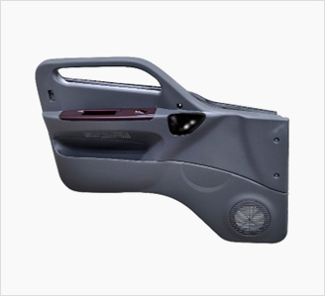
Application
Full door trim

Slide 2
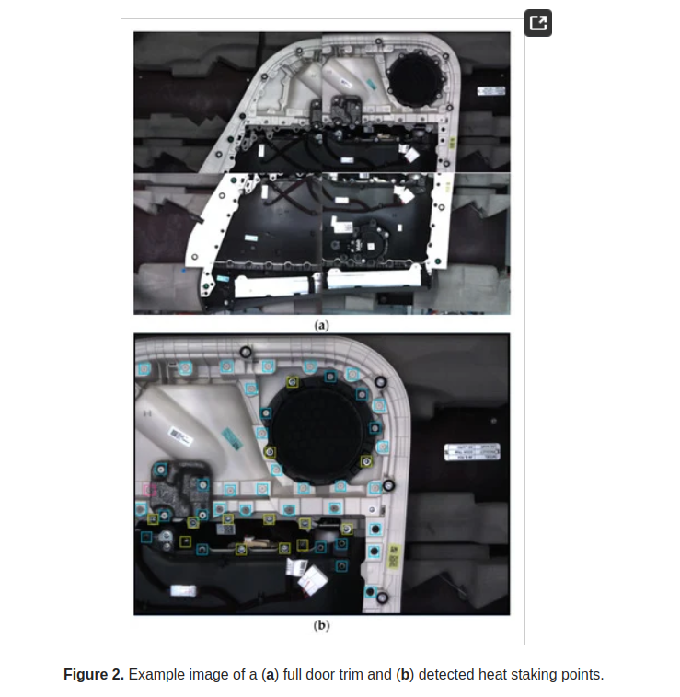
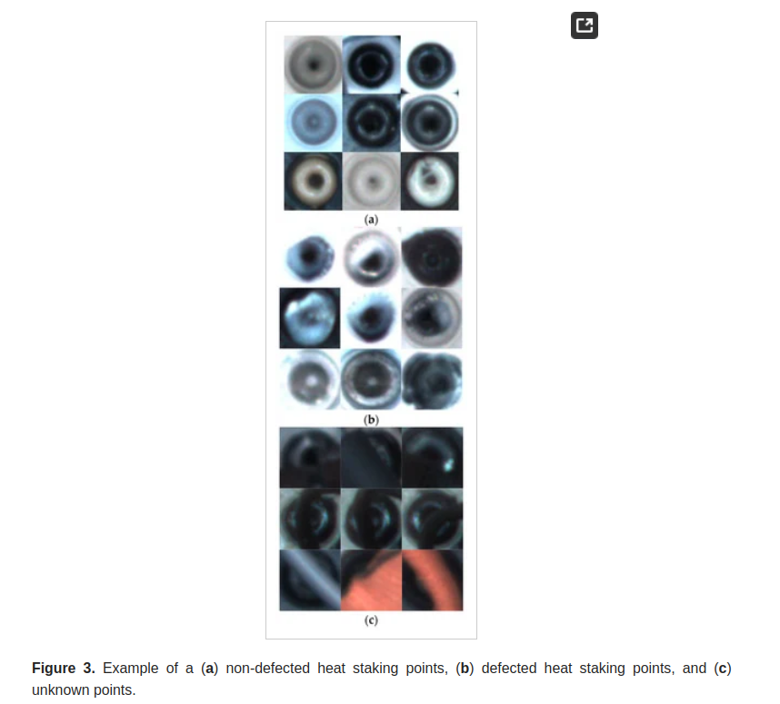

Slide 3
Game
https://youtu.be/na7gIcfBfDo

Slide 4
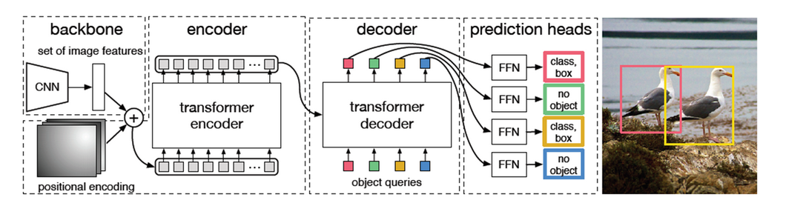
DETR(Detection with Transformer)

Slide 5
1. feature extraction
2. add positional encoding
3. cut by patch
4. number of bounding box (hyperparameter)
5. object queries (embedding → 각 bounding box에 대한 초기 정보 값)

